Slide 1


Low noise amplifier(LNA)
Design review
Presented by: Khaled Ahmed Swilam

Slide 2
agenda
Why we need LNA at the receiver?!
LNA architecture used
Technical flow
Design steps on virtuoso
Test-bench review
Dc operating point
S-parameters setup
Results && comments
P1dB setup
Results && comments
Linearity setup
Results && comments
Corner setup
Final results
Appendix

Slide 3
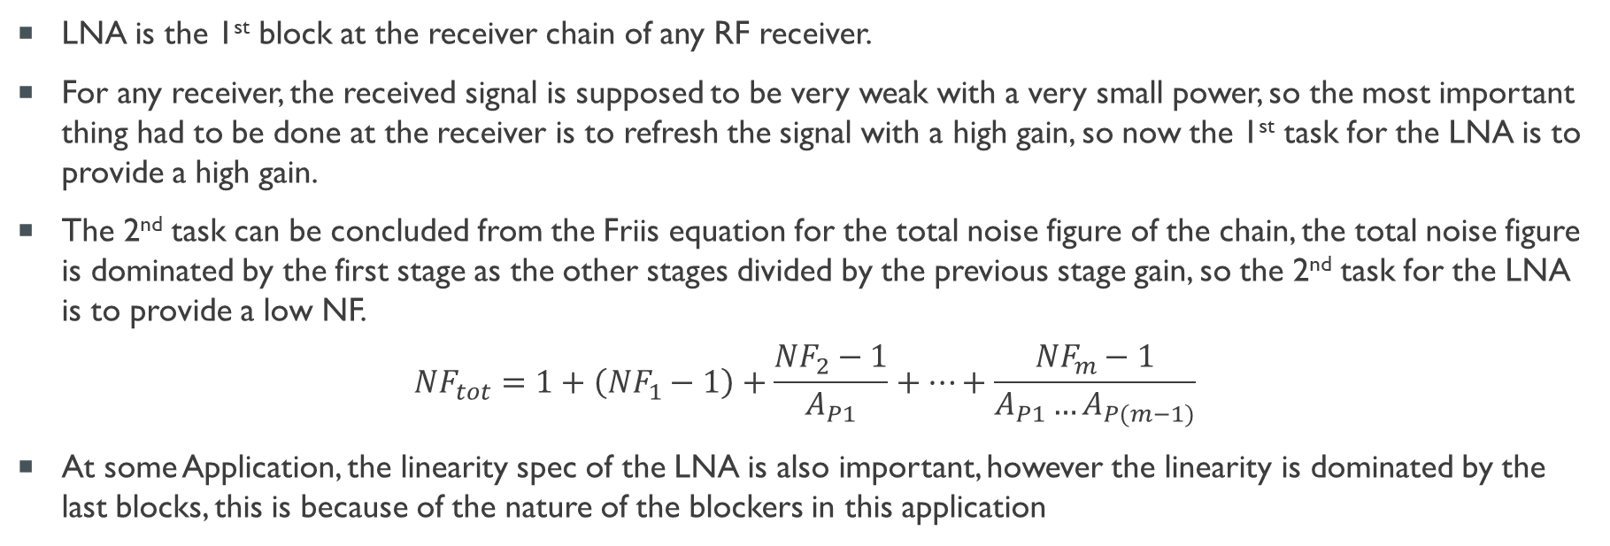
Why we need LNA at the receiver?!
LNA is the 1st block at the receiver chain of any RF receiver.
For any receiver, the received signal is supposed to be very weak with a very small power, so the most important thing had to be done at the receiver is to refresh the signal with a high gain, so now the 1st task for the LNA is to provide a high gain.
The 2nd task can be concluded from the Friis equation for the total noise figure of the chain, the total noise figure is dominated by the first stage as the other stages divided by the previous stage gain, so the 2nd task for the LNA is to provide a low NF.
$${NF}_{tot}=1+\left({NF}_{1}−1\right)+\frac{{NF}_{2}−1}{A_{P1}}+…+\frac{{NF}_{m}−1}{A_{P1}…A_{P(m−1)}}$$
At some Application, the linearity spec of the LNA is also important, however the linearity is dominated by the last blocks, this is because of the nature of the blockers in this application

Slide 4
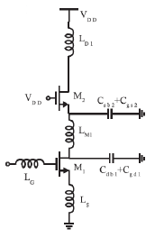
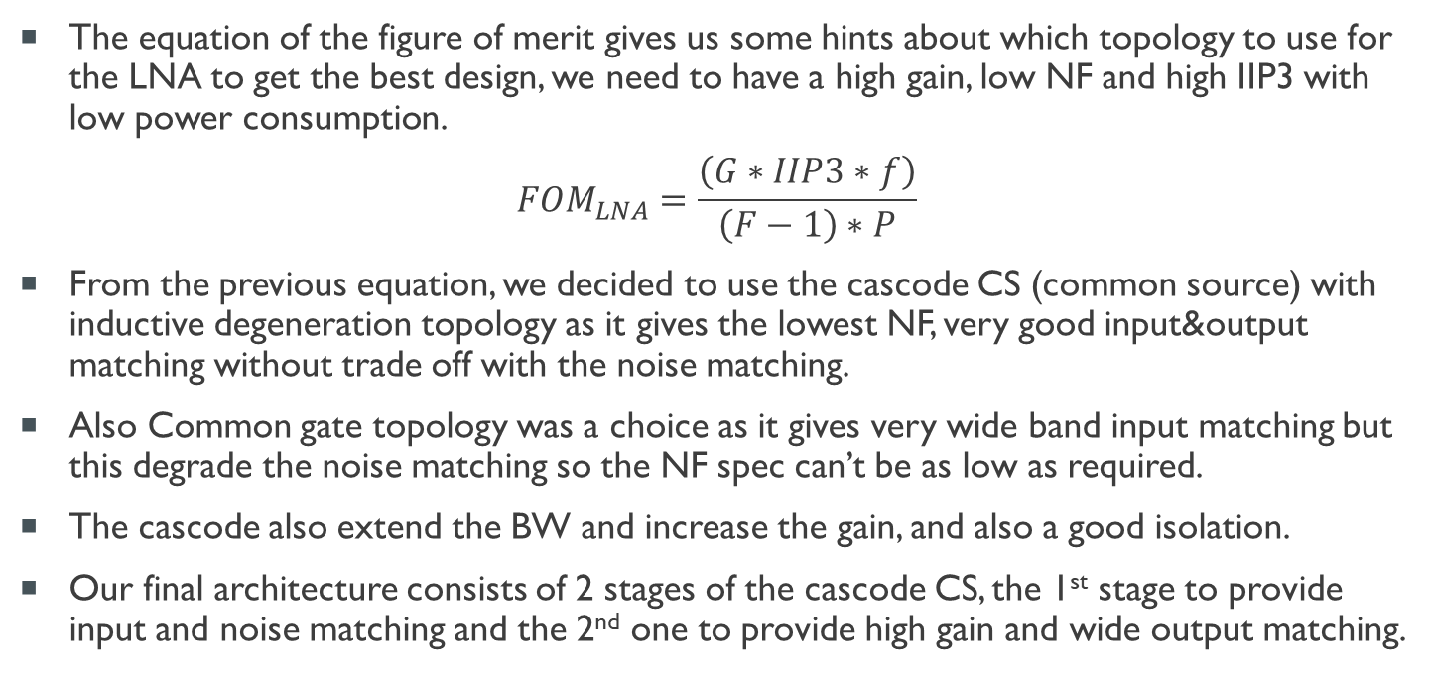
LNA architecture used
The equation of the figure of merit gives us some hints about which topology to use for the LNA to get the best design, we need to have a high gain, low NF and high IIP3 with low power consumption.
$${FOM}_{LNA}=\frac{\left(G∗IIP3∗f\right)}{\left(F−1\right)∗P}$$
From the previous equation, we decided to use the cascode CS (common source) with inductive degeneration topology as it gives the lowest NF, very good input&output matching without trade off with the noise matching.
Also Common gate topology was a choice as it gives very wide band input matching but this degrade the noise matching so the NF spec can’t be as low as required.
The cascode also extend the BW and increase the gain, and also a good isolation.
Our final architecture consists of 2 stages of the cascode CS, the 1st stage to provide input and noise matching and the 2nd one to provide high gain and wide output matching.

Slide 5
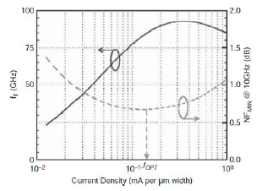
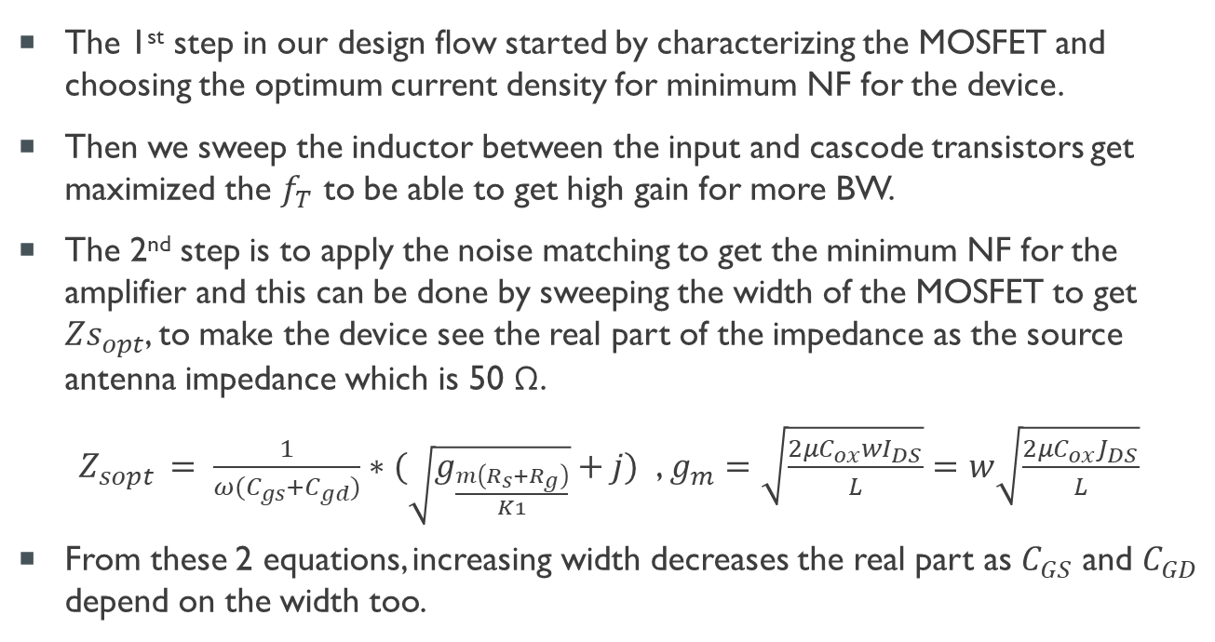
Technical flow
The 1st step in our design flow started by characterizing the MOSFET and choosing the optimum current density for minimum NF for the device.
Then we sweep the inductor between the input and cascode transistors get maximized the $f_{T}$ to be able to get high gain for more BW.
The 2nd step is to apply the noise matching to get the minimum NF for the amplifier and this can be done by sweeping the width of the MOSFET to get ${Zs}_{opt}$, to make the device see the real part of the impedance as the source antenna impedance which is 50 Ω.
$Z_{sopt }= \frac{1}{ω(C_{gs}+C_{gd})}∗(\sqrt{g_{\frac{m\left(R_{s}+R_{g}\right)}{K1}}}+j)$ , $g_{m}=\sqrt{\frac{2μC_{ox}wI_{DS}}{L}}=w\sqrt{\frac{2μC_{ox}J_{DS}}{L}}$
From these 2 equations, increasing width decreases the real part as $C_{GS}$ and $C_{GD}$ depend on the width too.

Slide 6
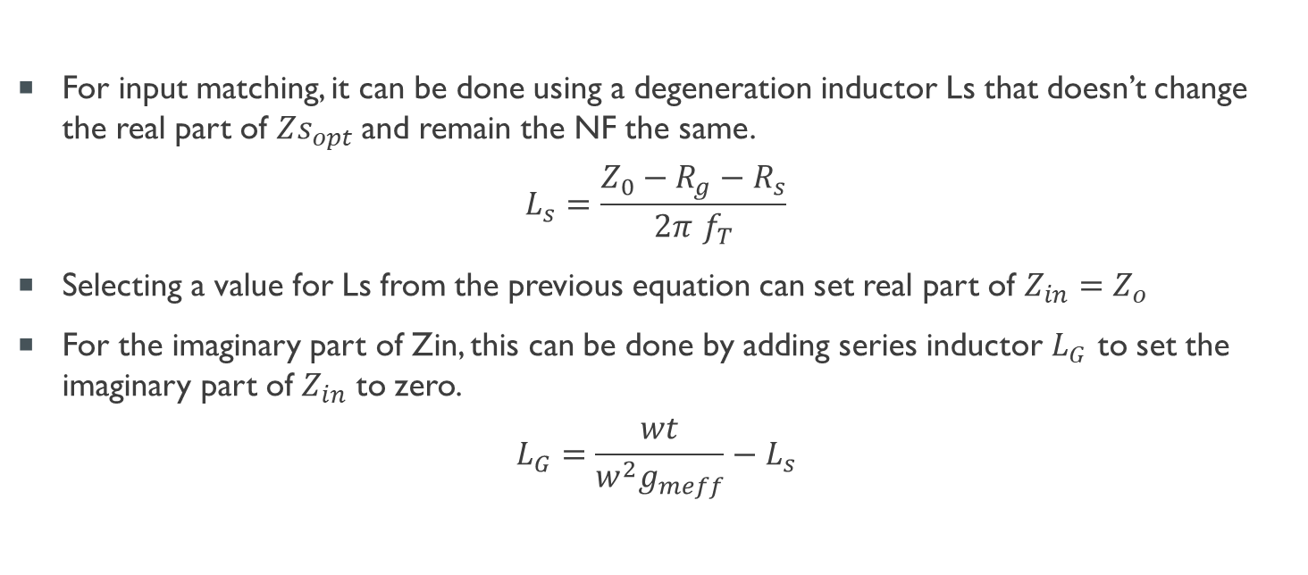
Technical flow cont.
For input matching, it can be done using a degeneration inductor Ls that doesn’t change the real part of ${Zs}_{opt}$and remain the NF the same.
$$L_{s}=\frac{Z_{0}−R_{g}−R_{s}}{2π f_{T}}$$
Selecting a value for Ls from the previous equation can set real part of $Z_{in}=Z_{o}$
For the imaginary part of Zin, this can be done by adding series inductor $L_{G}$ to set the imaginary part of $Z_{in}$ to zero.
$$L_{G}=\frac{wt}{w^{2}g_{meff}}−L_{s}$$

Slide 7
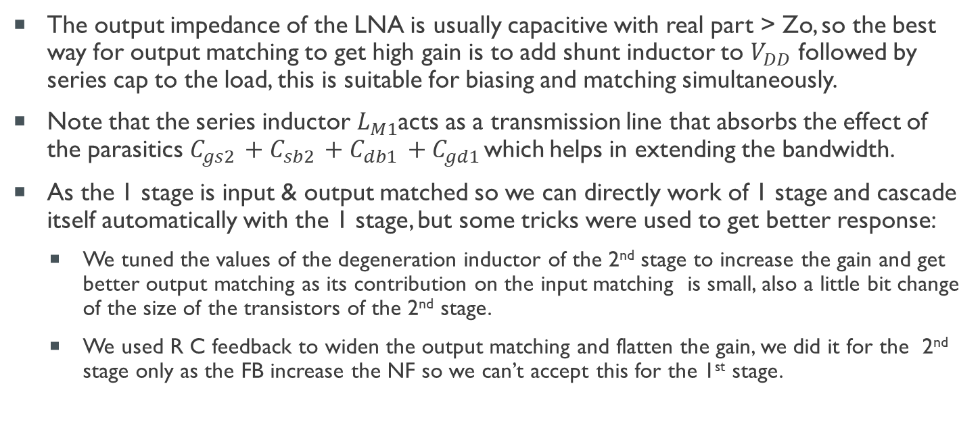
Technical flow cont.
The output impedance of the LNA is usually capacitive with real part > Zo, so the best way for output matching to get high gain is to add shunt inductor to $V_{DD}$ followed by series cap to the load, this is suitable for biasing and matching simultaneously.
Note that the series inductor $L_{M1}$acts as a transmission line that absorbs the effect of the parasitics$C_{gs2 }+C_{sb2 }+C_{db1 }+C_{gd1 }$which helps in extending the bandwidth.
As the 1 stage is input & output matched so we can directly work of 1 stage and cascade itself automatically with the 1 stage, but some tricks were used to get better response:
We tuned the values of the degeneration inductor of the 2nd stage to increase the gain and get better output matching as its contribution on the input matching is small, also a little bit change of the size of the transistors of the 2nd stage.
We used R C feedback to widen the output matching and flatten the gain, we did it for the 2nd stage only as the FB increase the NF so we can’t accept this for the 1st stage.

Slide 8
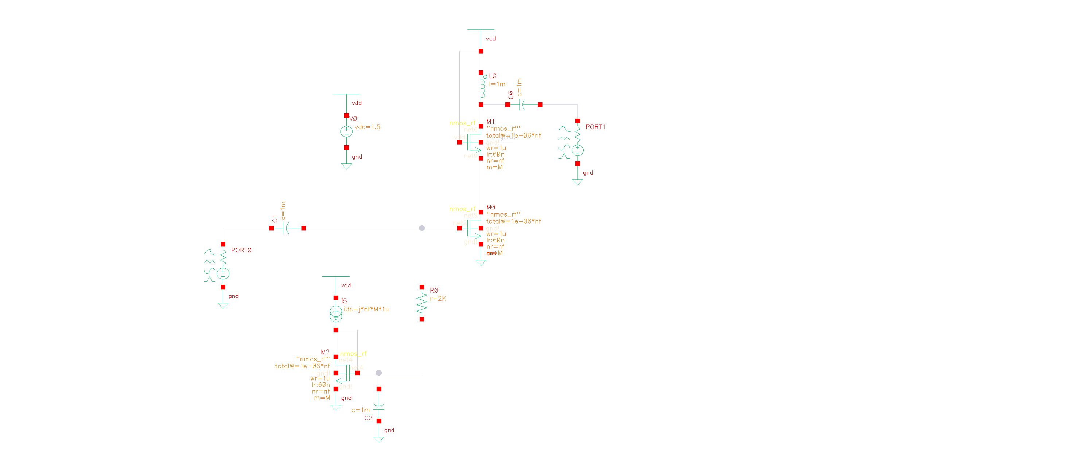
Design steps on virtuoso
The shown figure shows the testbench used to characterize the MOSFET and choose initial values for the components

Slide 9
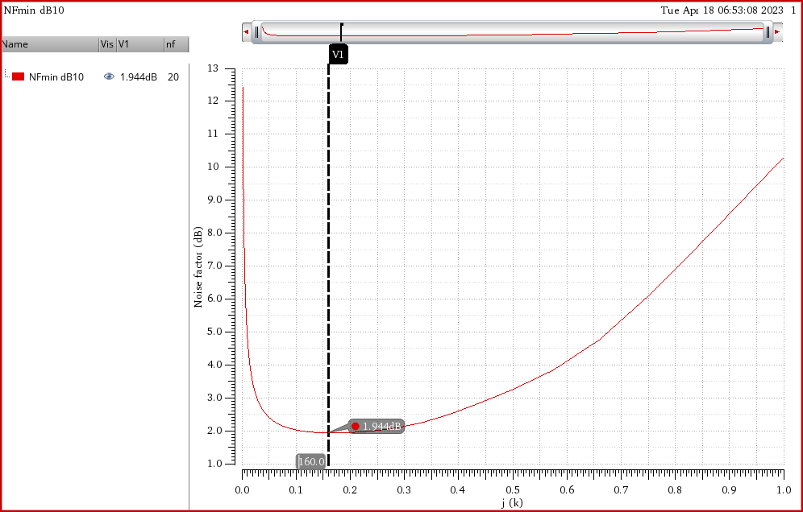
Design steps on virtuoso
We then decided the optimum current density that corresponds to the minimum NF.

Slide 10
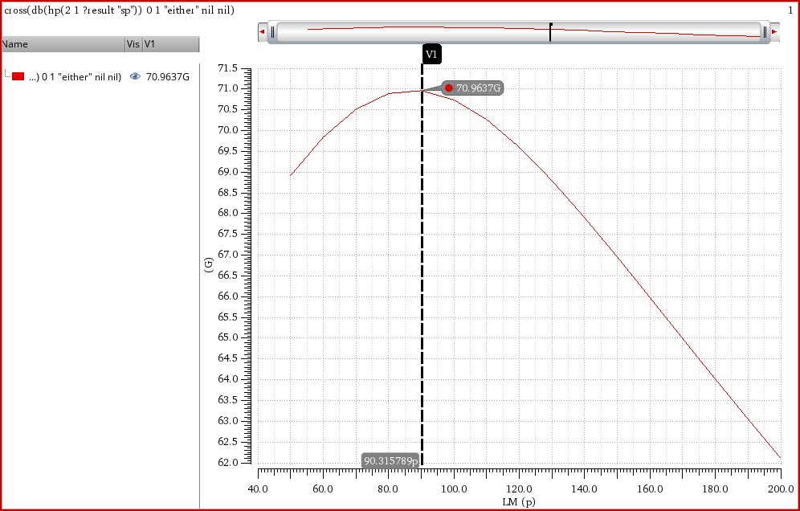
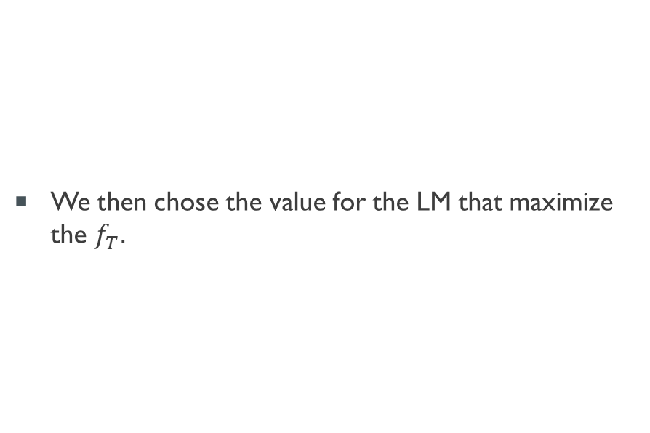
Design steps on virtuoso
We then chose the value for the LM that maximize the $f_{T}.$

Slide 11
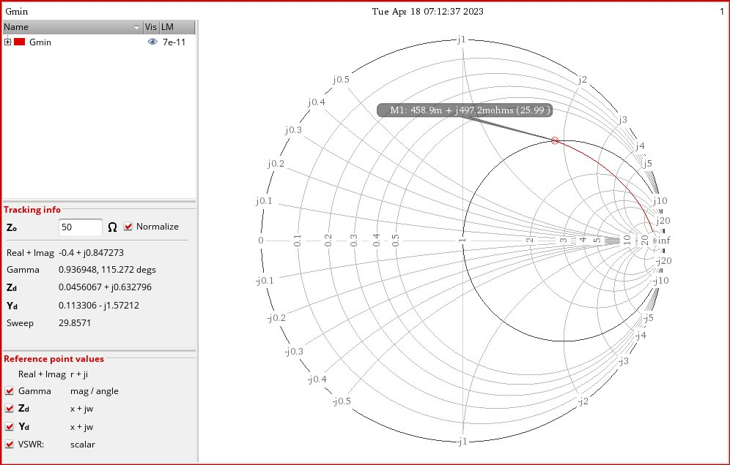
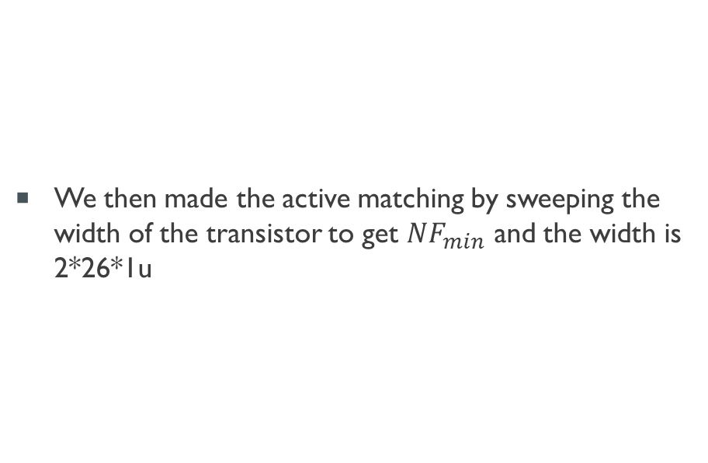
Design steps on virtuoso
We then made the active matching by sweeping the width of the transistor to get $NF_{min}$ and the width is 2*26*1u

Slide 12
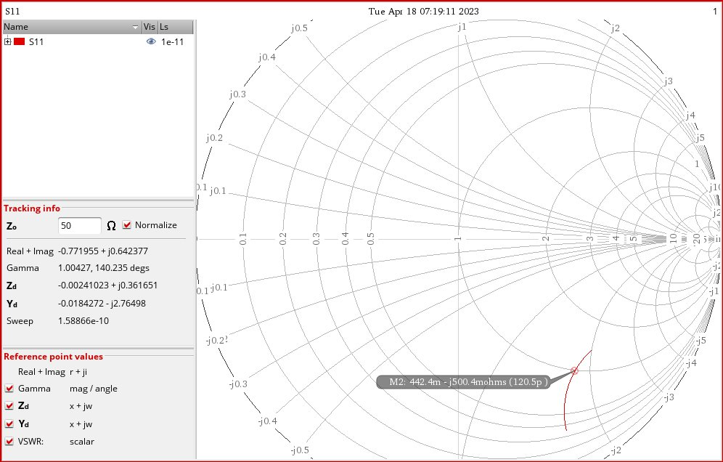
Design steps on virtuoso
We then made the power matching using inductive degeneration and get its value to cancel the imaginary part of the input impedance.

Slide 13
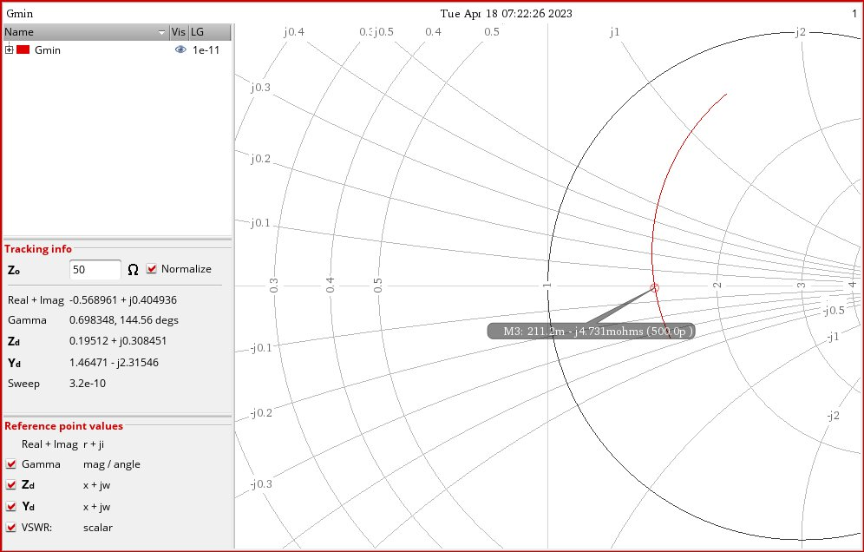
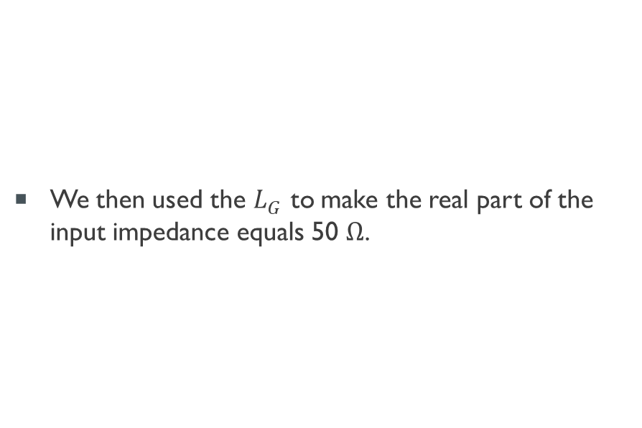
Design steps on virtuoso
We then used the $L_{G}$ to make the real part of the input impedance equals 50 $Ω$.

Slide 14
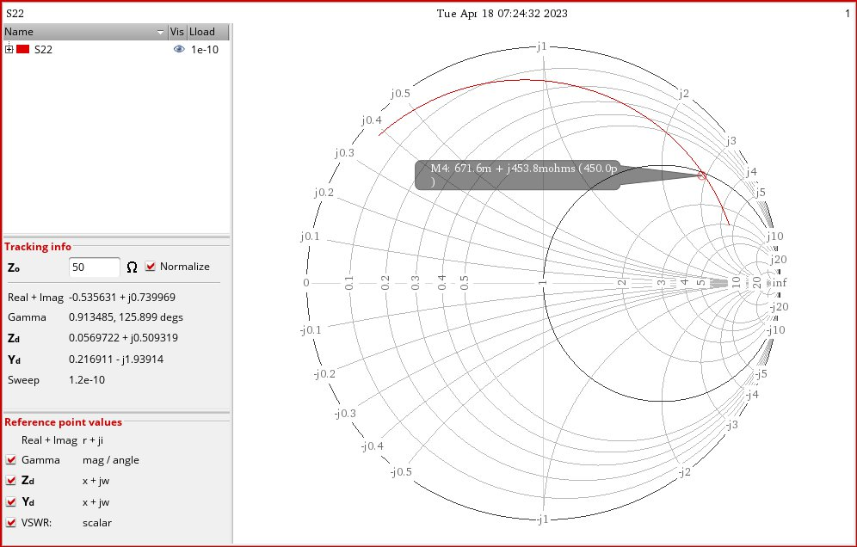
Design steps on virtuoso
After finishing the power&noise matching we turned to output matching, we used the biasing T network to match the output impedance, we sweeped the value of the choke inductor to cancel the imaginary part.

Slide 15
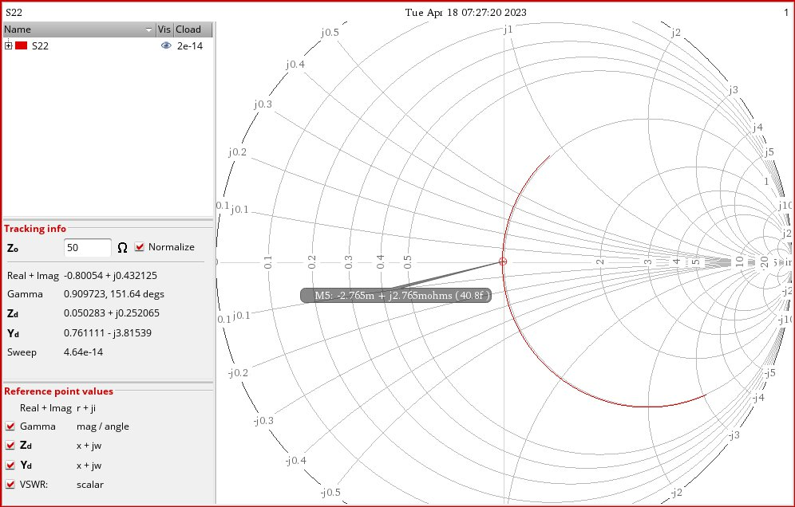
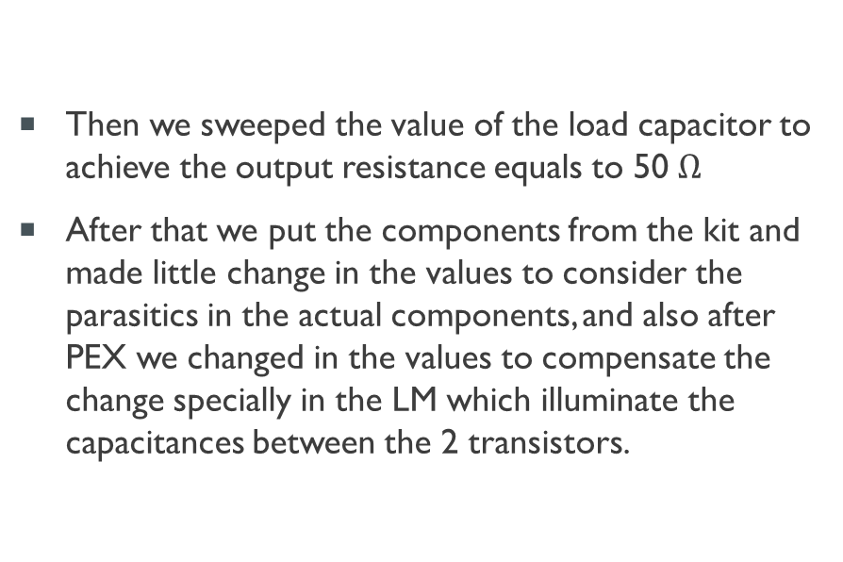
Design steps on virtuoso
Then we sweeped the value of the load capacitor to achieve the output resistance equals to 50 $Ω$
After that we put the components from the kit and made little change in the values to consider the parasitics in the actual components, and also after PEX we changed in the values to compensate the change specially in the LM which illuminate the capacitances between the 2 transistors.

Slide 16
Test-bench review
At this part we are going to show our flow on cadence to design the LNA as discussed in the previous slides.
The next slide show our schematic used for the test-bench, this test-bench run dc analysis and S-Parameters analysis to get the input matching, output matching, NF, K factor, linearity and gain calculations and check their values after applying the RC extraction on the MOSFETS used.
This test-bench is used to run at first dc operating point, s-parameters analysis and linearity with different setups, for the following slides we will discuss all the results and comment on them.

Slide 17
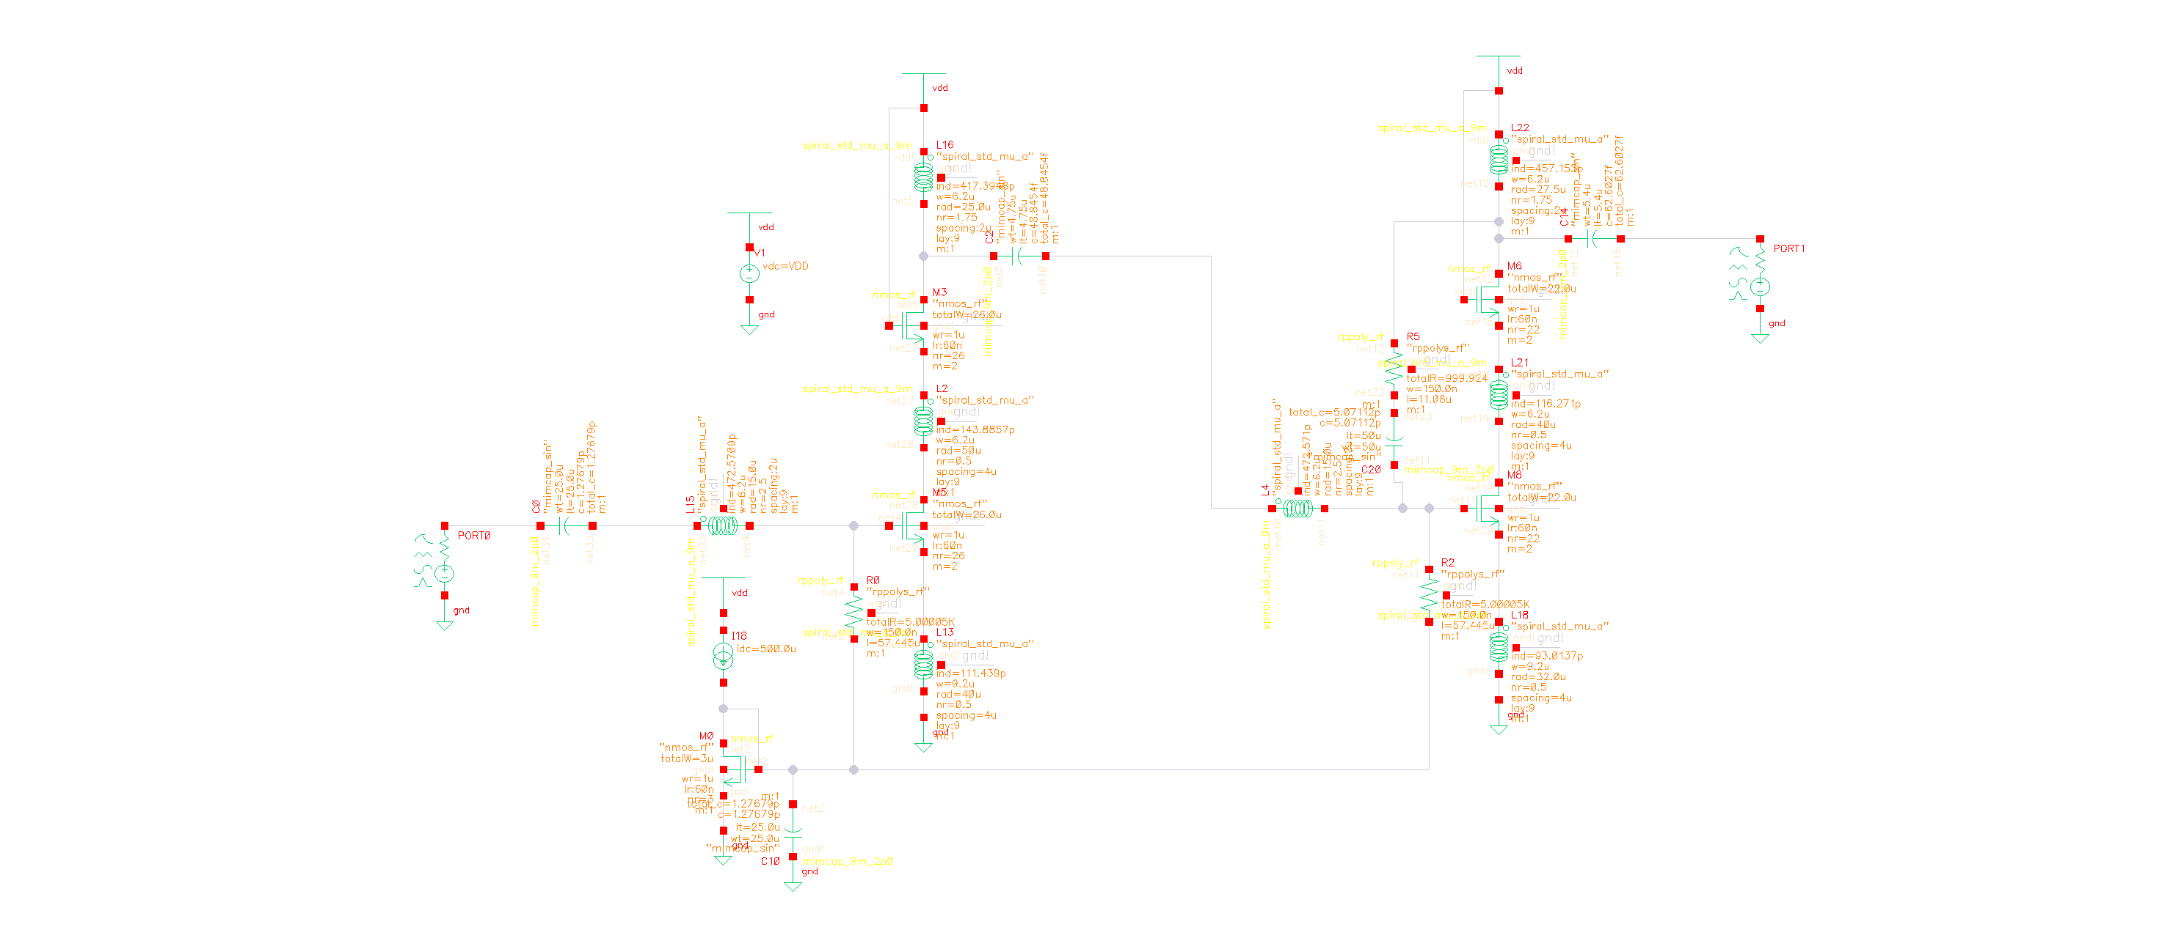

Slide 18
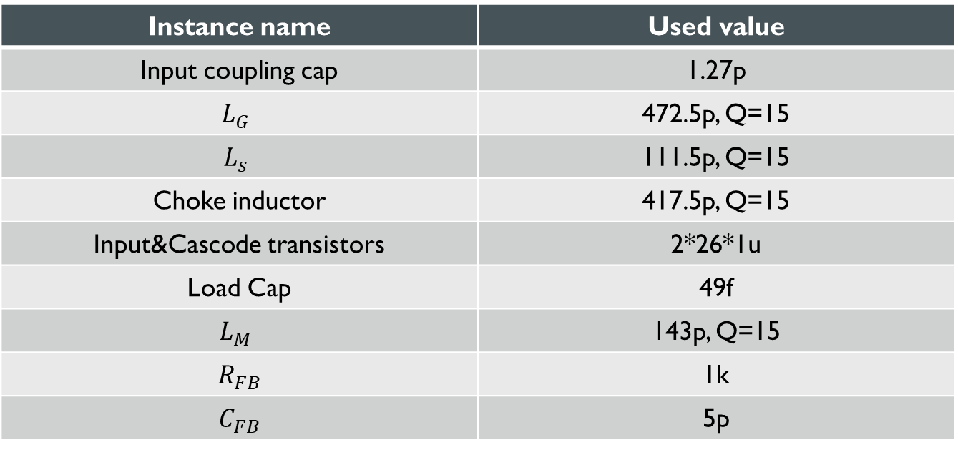
Dc operating point
Before going through the S-Parameters analysis the following table shows the design variables and their values also the next slide show the dc operating point.
Instance name | Used value
Input coupling cap | 1.27p
$$L_{G}$$ | 472.5p, Q=15
$$L_{s}$$ | 111.5p, Q=15
Choke inductor | 417.5p, Q=15
Input&Cascode transistors | 2*26*1u
Load Cap | 49f
$$L_{M}$$ | 143p, Q=15
$$R_{FB}$$ | 1k
$$C_{FB}$$ | 5p

Slide 19
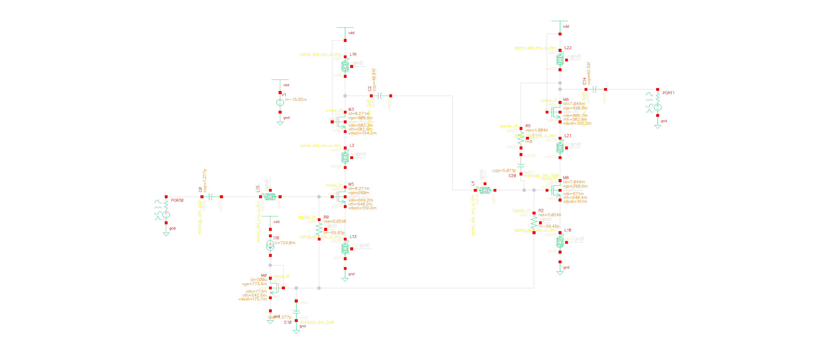

Slide 20
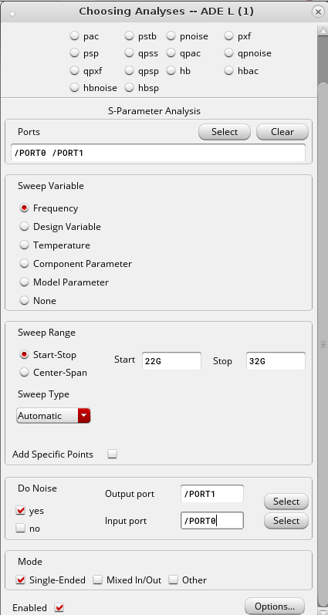
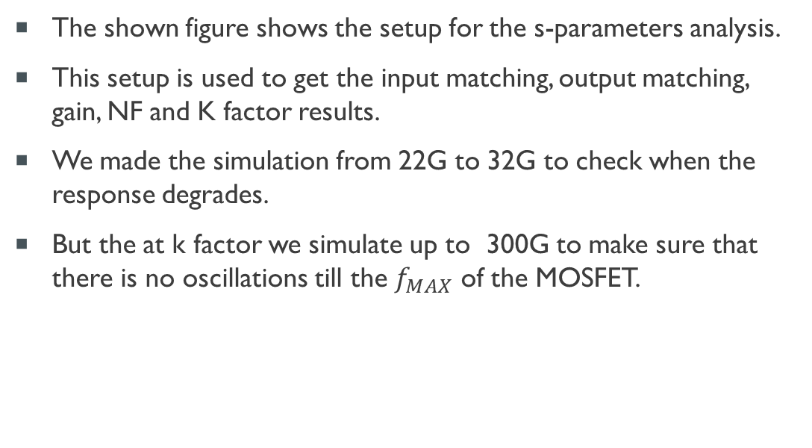
S-parameters setup
The shown figure shows the setup for the s-parameters analysis.
This setup is used to get the input matching, output matching, gain, NF and K factor results.
We made the simulation from 22G to 32G to check when the response degrades.
But the at k factor we simulate up to 300G to make sure that there is no oscillations till the $f_{MAX}$ of the MOSFET.

Slide 21
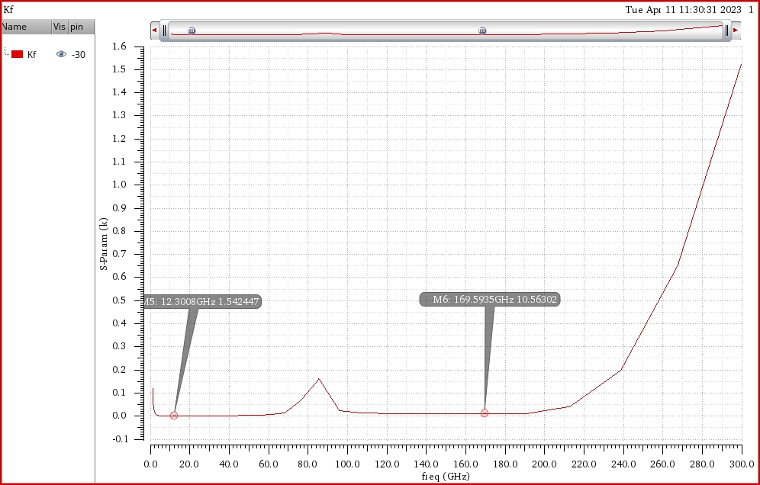
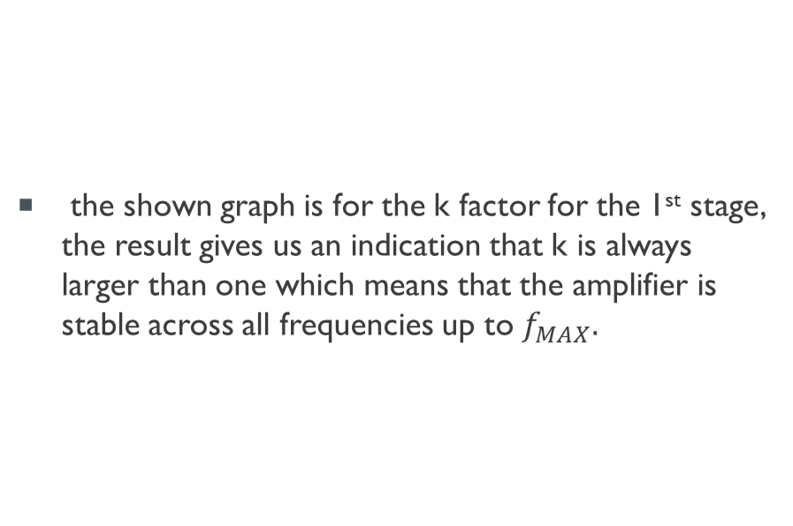
Results && comments
the shown graph is for the k factor for the 1st stage, the result gives us an indication that k is always larger than one which means that the amplifier is stable across all frequencies up to $f_{MAX}.$

Slide 22
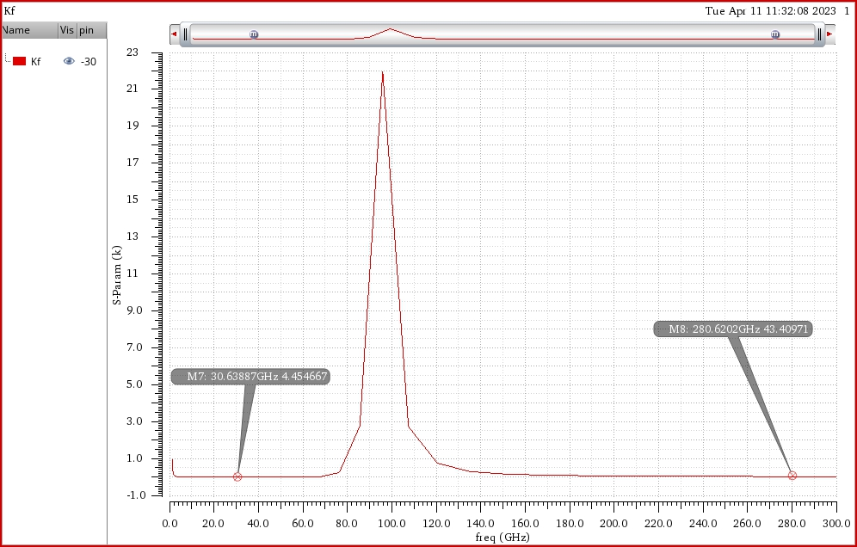
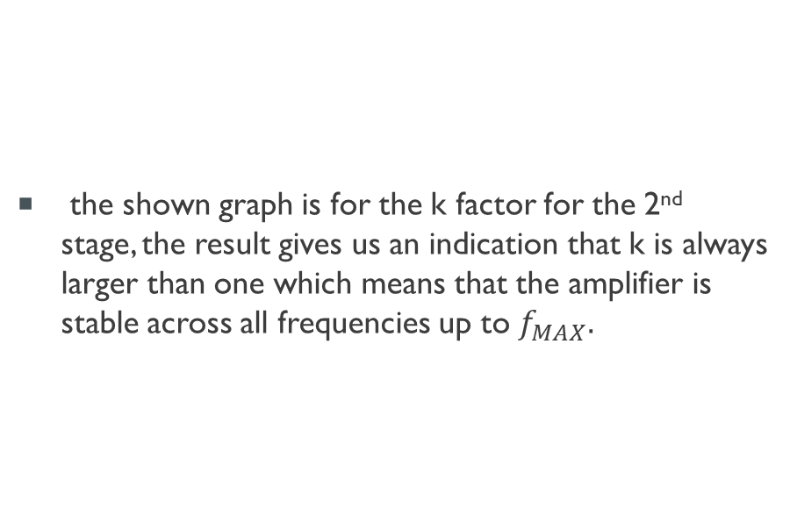
Results && comments
the shown graph is for the k factor for the 2nd stage, the result gives us an indication that k is always larger than one which means that the amplifier is stable across all frequencies up to $f_{MAX}.$

Slide 23
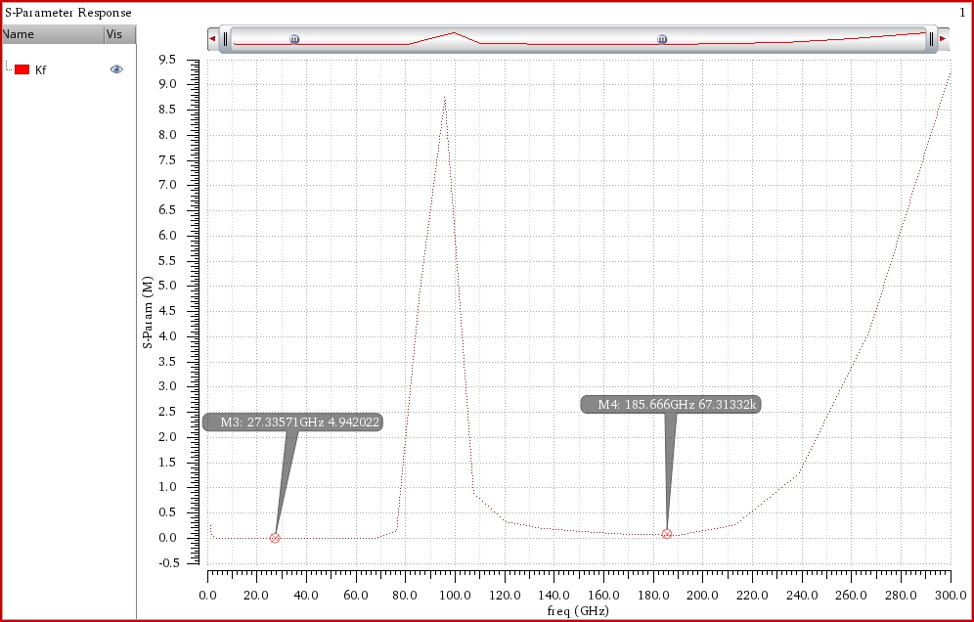
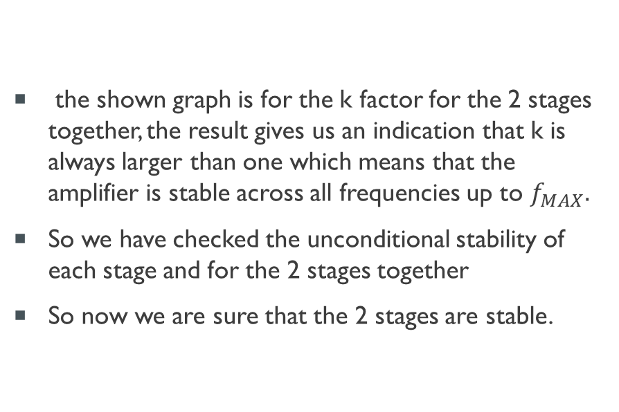
Results && comments
the shown graph is for the k factor for the 2 stages together, the result gives us an indication that k is always larger than one which means that the amplifier is stable across all frequencies up to $f_{MAX}.$
So we have checked the unconditional stability of each stage and for the 2 stages together
So now we are sure that the 2 stages are stable.

Slide 24
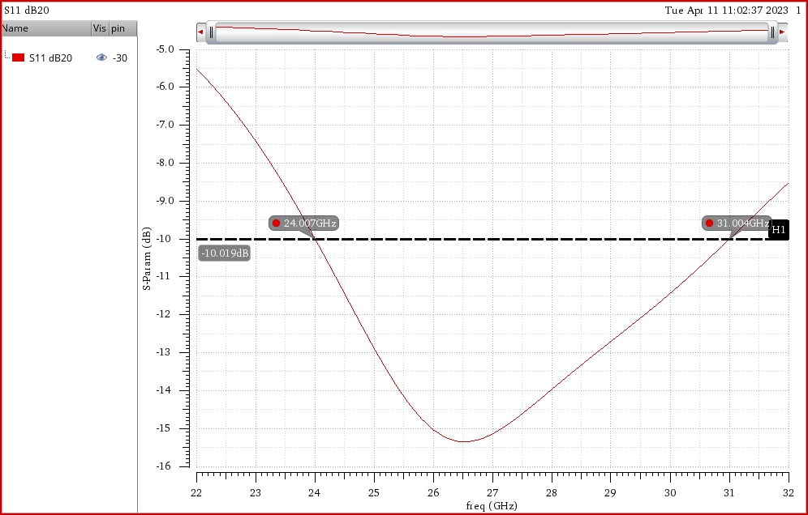
Results && comments
the shown graph is for the input matching, the result is accepted as in the range between 24 to 30 GHZ, the s11 is below -10 dB as required.

Slide 25
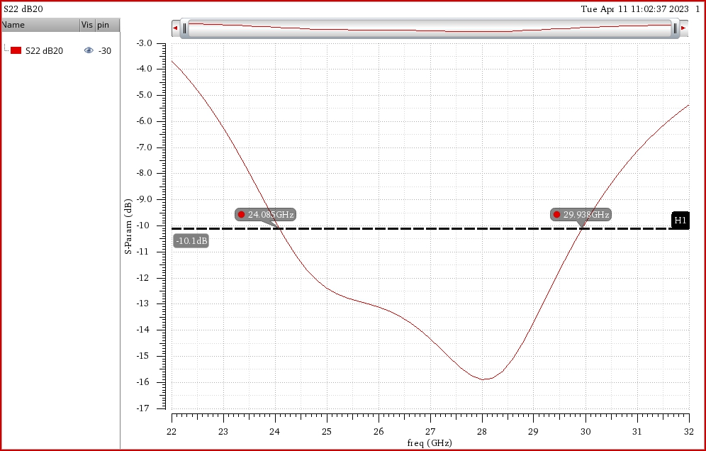
Results && comments
the shown graph is for the output matching, the result is accepted as in the range between 24 to 30 GHZ, the s22 is below -10 dB as required.

Slide 26
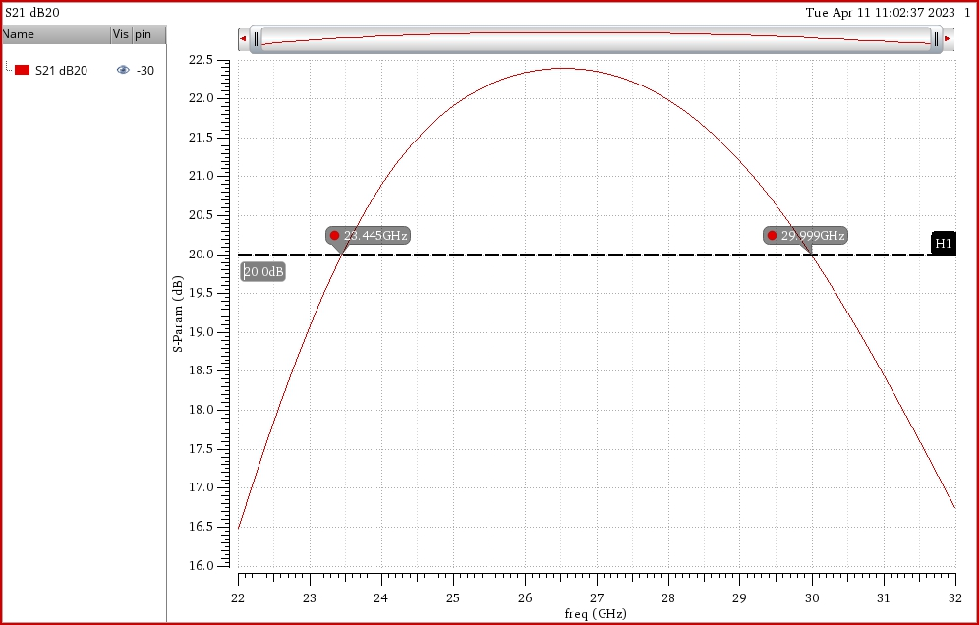
Results && comments
the shown graph is for the gain, the result is accepted as in the range between 24 to 30 GHZ, the s21 is above 20 dB as required, also the gain is almost flat as the roll off in the band is almost 2dB which good specially in multistage architecture.

Slide 27
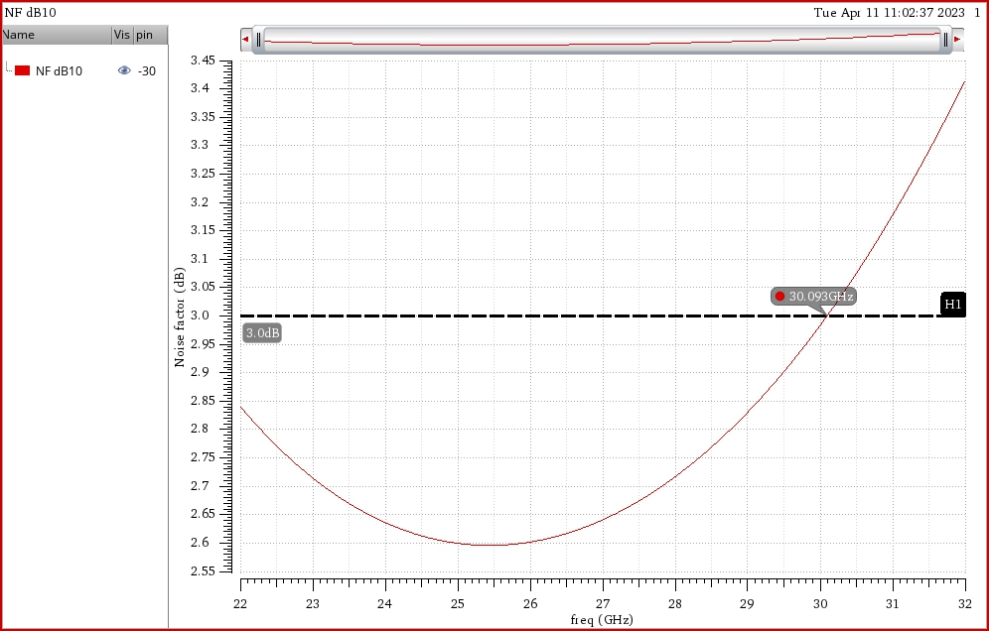
Results && comments
the shown graph is for the NF, the result is accepted as in the range between 24 to 30 GHZ, the NF is below 3 dB as Required.

Slide 28
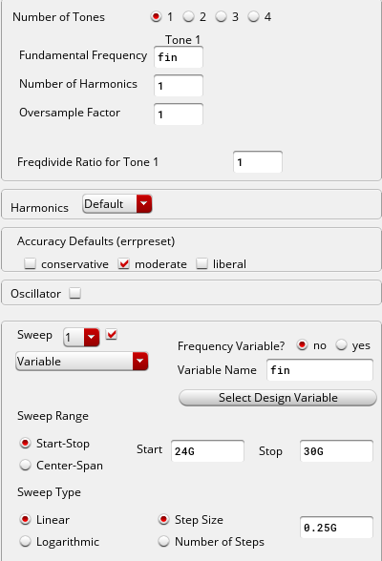
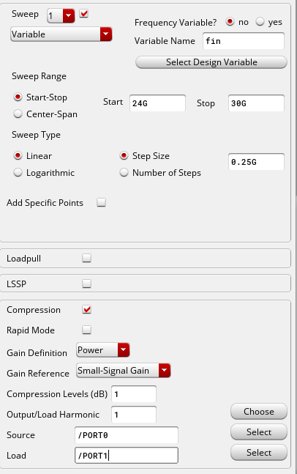
P1dB setup
the shown figure shows the P1dB setup.
This setup is used to get P1dB and check its value across the desired range of operation.
Hb analysis was used for this output.
One input tone was at the input port in the schematic.

Slide 29
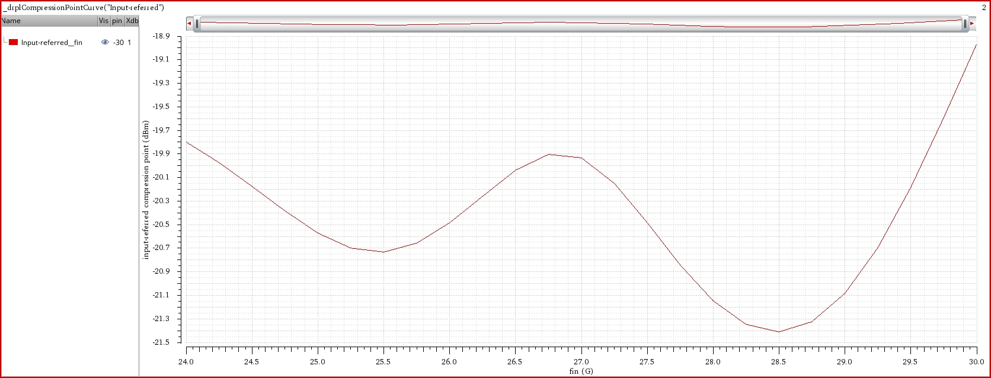
Results && comments
the shown graph is for the P1dB, the result is accepted from 24 to 30 GHz as its value is between -21.5dBm and -19dBm, so if used the theoretical estimation, the IIP3 will be about -10dBm which is very good compared to the required spec, and this also will be shown by actual result simulation.

Slide 30
Linearity setup
The next slide show the setup used for linearity analysis.
This setup is used to get the IIP3 across the desired range of frequency and check if the values are accepted or not as done before.
Hb analysis was used for this output, by putting 2 tones at the input with the same input power and the spacing between them is 200MHz which is 0.5*BW of the 5G signals.

Slide 31
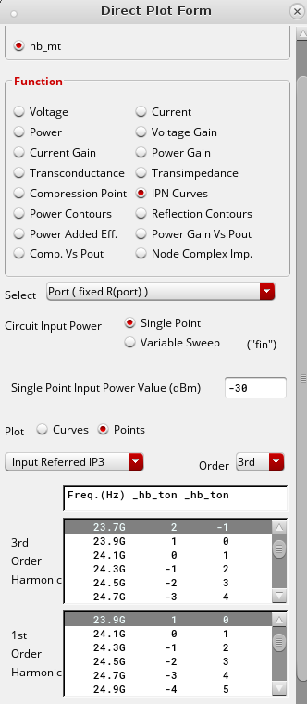
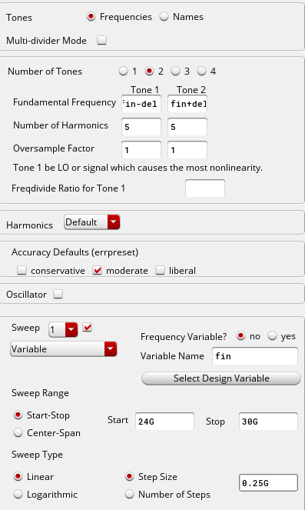
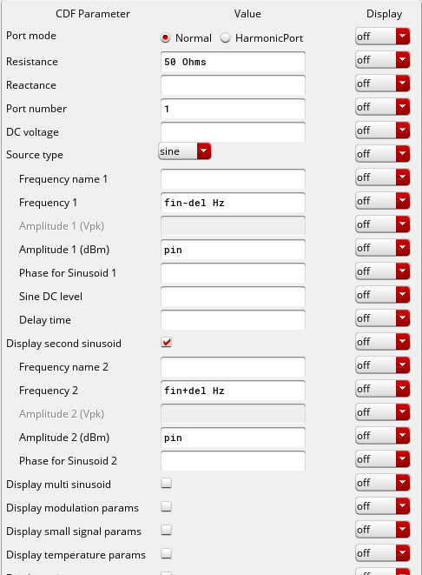
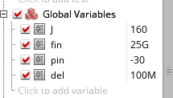

Slide 32
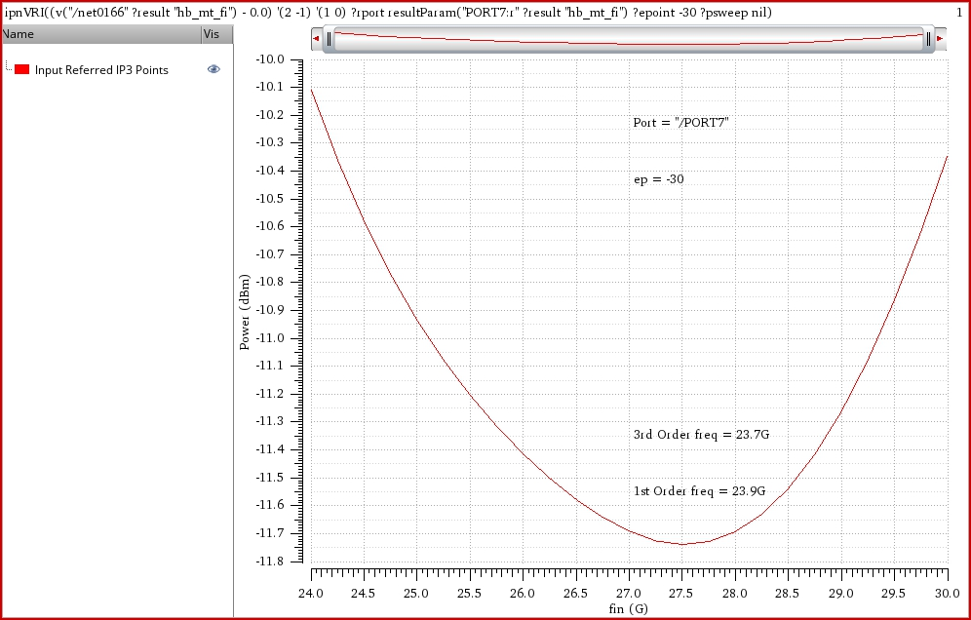
Results && comments
the shown graph is for the IIP3, the result is accepted as the IIP3 from 24 to 30 GHz is above -20dBm as required, so the design has a very good linearity spec compared to required.

Slide 33
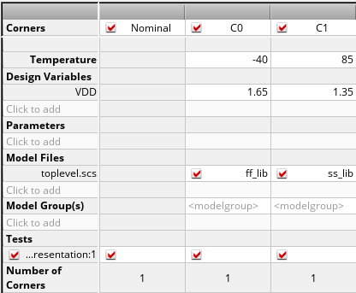
Corner setup
The shown figure shows the corner setup used.
This setup is used to compare the previous results at different temperature and supply values to see the differences and if our design fits these corners.

Slide 34
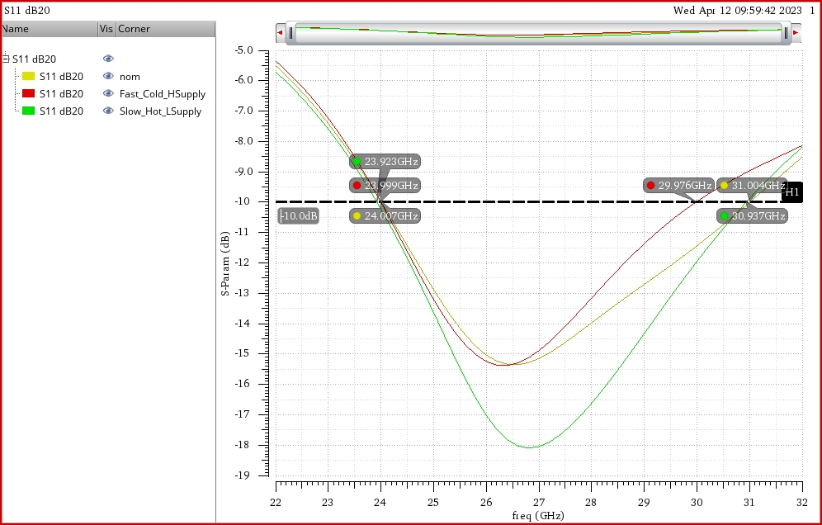
Final results
the shown graph shows the input matching, the spec on s11 is achieved for all corner models as s11 is below -10 dB from 24 to 30 GHz, so the design provides a good input matching for all corner models.

Slide 35
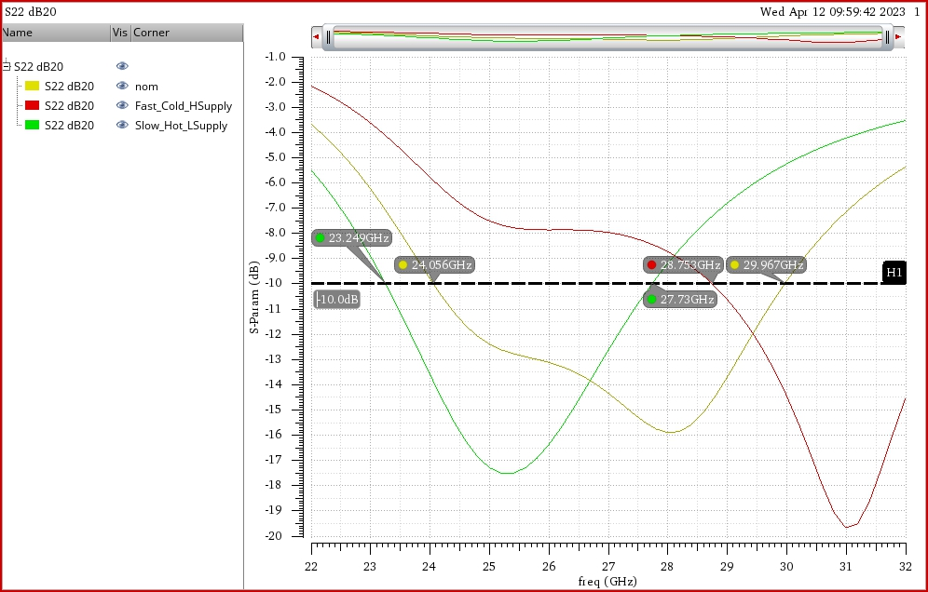
Final results
the shown graph shows the output matching, the spec on s22 is achieved for normal model and shifted right and left for the other corner models, so we can say that the output matching is sensitive to the corner models.
The fast, cold high supply skewed to high frequency, and vice versa about slow, hot, low supply.
Slow, hot, low supply skew was small, about 1.5G, but the other corner skewed a lot to the higher band, but still give good response at the low frequency which is about -7dB for s22.
These variations maybe because of that the value of the load cap is small so it’s sensitive to any variation in process and temperature.

Slide 36
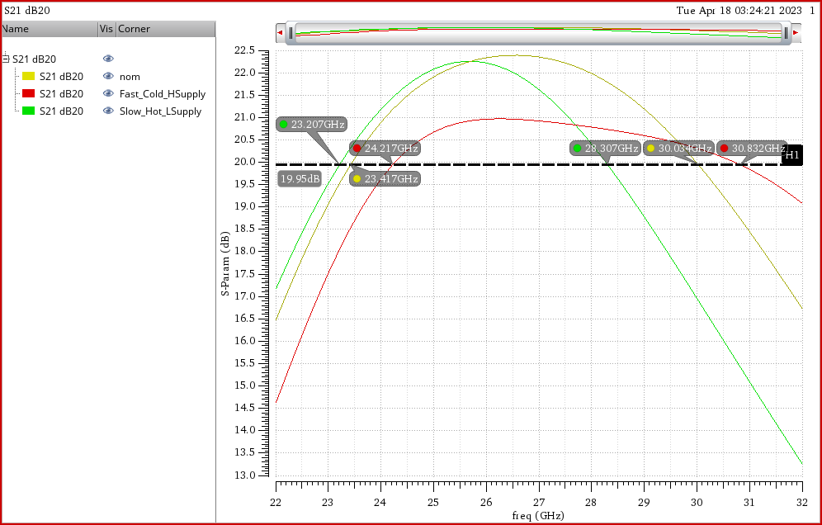
Final results
the shown graph shows the gain, the spec on s21 is achieved for the nominal model and also for fast cold high supply model but at slow hot low supply the center frequency has shifted to lower frequency so the gain of 20dB isn’t achieved almost from 19GHz to the end of the band.

Slide 37
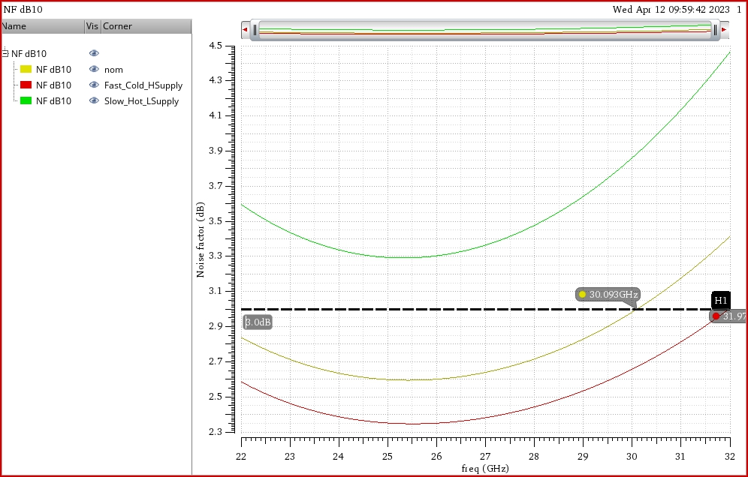
Final results
the shown graph shows the noise figure, the spec on NF is achieved for the normal model and the fast cold high supply model and for the slow one NF is below 3.9 dB, so the design provides a good NF for normal and fast models and the NF degrades a little for the slow hot model which is predictable, the high NF in the case of slow hot low supply can be calibrated by using the current reference as PTAT Current to increase the current as the temperature rise also it improves the gain at this case.

Slide 38
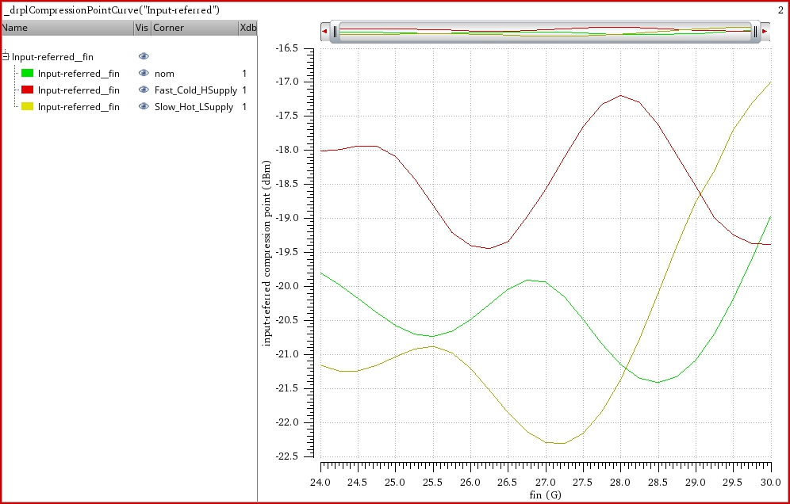
Final results
the shown graph shows the P1dB, the design provides good values for P1dB for all the corner models tested on it.

Slide 39
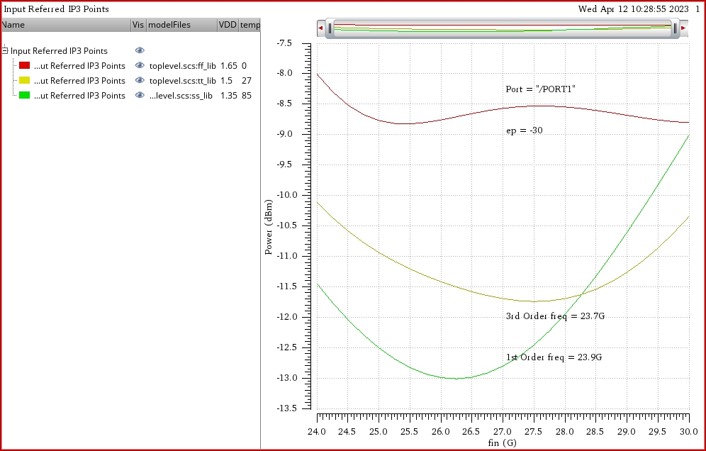
Final results
the shown graph shows the IIP3, the spec on IIP3 is achieved for all the corner models as they all above -20 dBm, so the design provides a good linearity for all corner models tested.

Slide 40
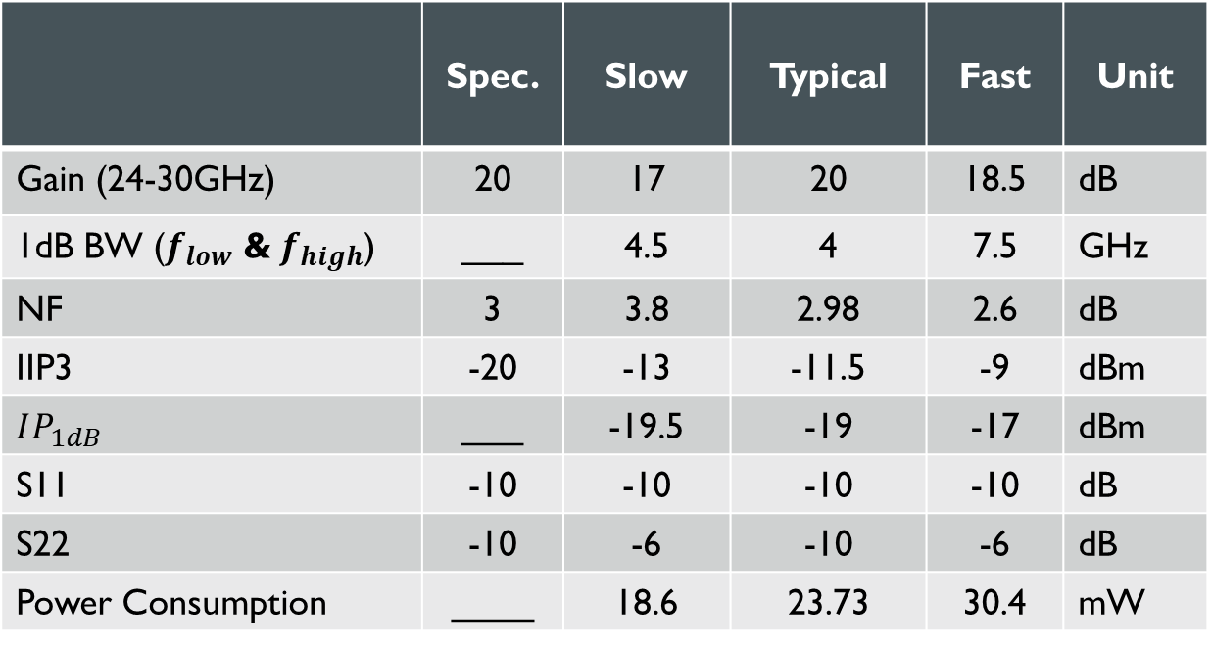
Final results
 | Spec. | Slow | Typical | Fast | Unit
Gain (24-30GHz) | 20 | 17 | 20 | 18.5 | dB
1dB BW ($f_{low}$ &$f_{high}$) | ___ | 4.5 | 4 | 7.5 | GHz
NF | 3 | 3.8 | 2.98 | 2.6 | dB
IIP3 | -20 | -13 | -11.5 | -9 | dBm
$$IP_{1dB}$$ | ___ | -19.5 | -19 | -17 | dBm
S11 | -10 | -10 | -10 | -10 | dB
S22 | -10 | -6 | -10 | -6 | dB
Power Consumption | ____ | 18.6 | 23.73 | 30.4 | mW

Slide 41

Appendix
the shown graph shows the Extracted MOSFET used in the design.

